Slide 1
Welcome to Modeling Earth’s Climate!
Let’s check out the syllabus on Canvas, especially
Resources you’ll need
Rhythm of the week
What CGIs are
Contingencies for missing class
Evaluation
Topic schedule

Slide 2
Why (and how) to learn to model Earth’s climate?
Construct models and run them
Run existing (“canned”) models
Critique the results, revise assumptions

Slide 3
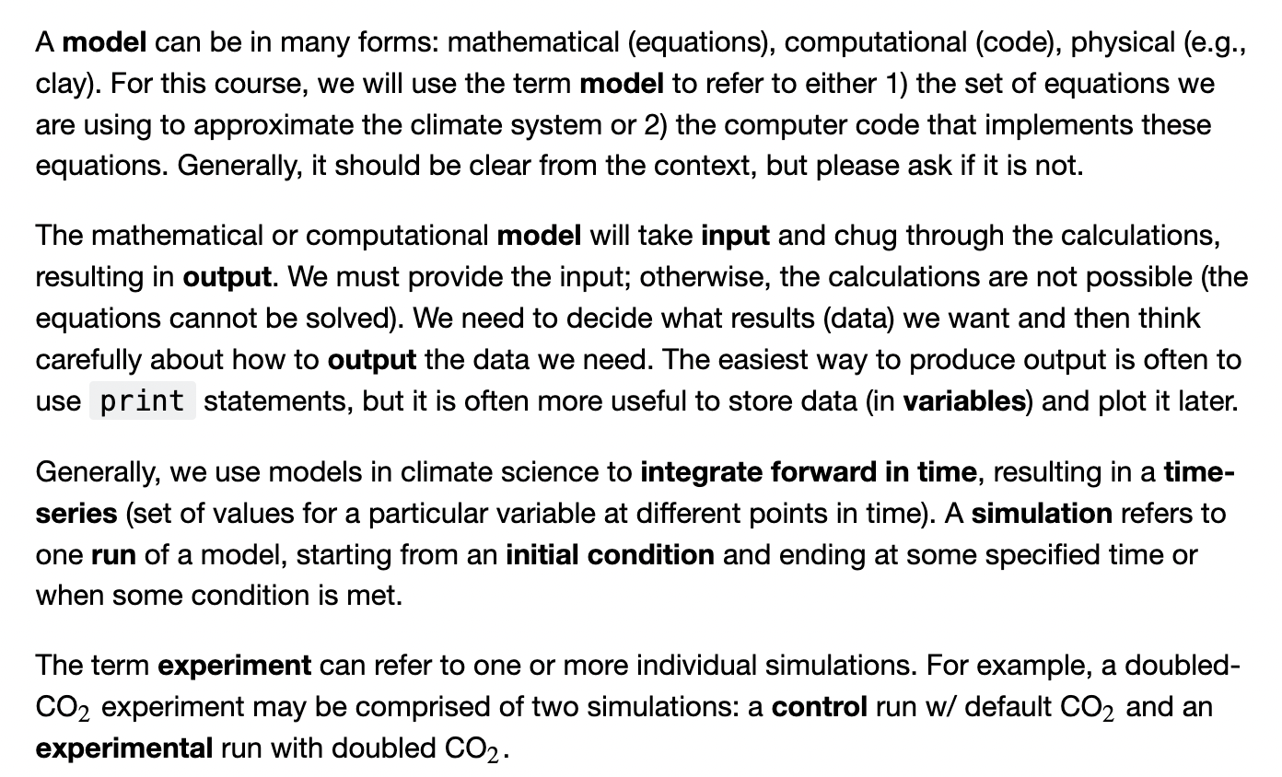
What is a model, anyway*?
*From Professor Karen Shell, Oregon State University

Slide 4
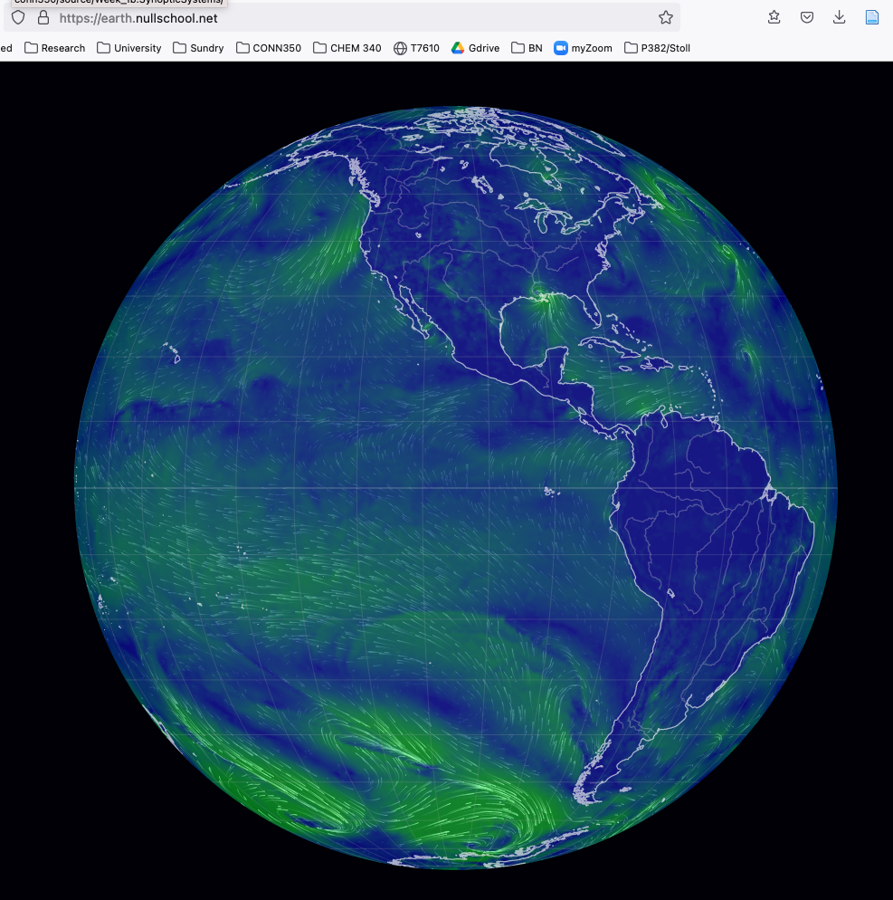
Earth.nullschool.net
What you’ll do:
Mess with this model and learn what you can. I have some ideas, but you can take it where you want to.
Copy/paste into your research notebook.
What I hope you’ll get from it:
A global perspective
Familiarity with some basics of weather (since weather is the basis of climate)

Slide 5
Ideas …
I. Surface air pollutant concentrations.
What this tells you: Concentrations of Carbon Monoxide (a highly toxic air pollutant)
Questions to ponder:
How bad is China’s urban air problem?
How bad is it elsewhere?
What role that might be playing in a nation’s interest in eliminating fossil fuel usage? (see, e.g., https://chinaproject.harvard.edu/publications/effects-energy-paths-and-emission-controls-and-standards-future-trends-chinas-emissions-0)

Slide 6
II. Fires.
What this tells you: Where major fires are at any given time.
Questions to ponder:
Is there a correlation?
Is there causality? (see, e.g., https://www.dailycal.org/2016/05/04/researchers-discover-wildfires-correlate-human-activity-climate-change/).
Check out Brazil too

Slide 7
III. The jet stream
What this tells you: To the north of the stream is cold Arctic air, to the south warm air.
Some Questions to ponder:
Was the mid-June “heat dome” episode related to the jet stream (yes).
Are these undulations getting more pronounced with climate change (yes – this is the Francis/Vavrus theory)
How do climate change nay-sayers respond? (see, e.g., https://notalotofpeopleknowthat.wordpress.com/2016/03/05/meteorologist-trashes-jennifer-francis-extreme-weather-theory/)

Slide 8
IV. Surface CO₂ concentrations
What this tells you: Red => low concentration, hence a CO₂ sink
Questions:
Does this pattern change with the seasons (yes).
Who pays to protect the rainforests? (see, e.g., https://www.msn.com/en-us/news/world/brazil-s-bolsonaro-rejects-biden-s-offer-of-20-billion-to-protect-the-amazon/ar-BB19AcwL)

